Slide 1


Deloitte TechnoUtsav 3.0
PLANT DOCTOR
IIT Bhilai_404 ERROR

Slide 2
Content
01 Motivation to solve the problem
02 Issues and Solutions
03 Limitations and Future direction

Slide 3
Motivation to solve the problem

Slide 4
Plant diseases and pests are widely considered an important cause of crop losses, and sometimes a threat to the food supply.
We are losing a significant amount of yield on a global scale to pests and diseases, at a time when we must increase production to feed a growing population.
People not being able to recognize the disease
in the early stages due to which the spread of the disease increases.

Slide 5
Issues and Solutions

Slide 6
Issues
The naked eye observation of experts is the main approach adopted in practice for detection and identification of plant diseases. However, this may not be too helpful and requires too many experts which might be prohibitively expensive in large farms.
Due to fear of attack of pests/diseases, agriculturalist uniformly sprays pesticides/fertilizers in whole farm which may lead to damage of soil as well as plant.
The usage of excess fertilizer alters the soil by creating too high of a salt concentration.
Solutions
We created a Telegram bot that takes leaf images as input and returns the output whether the given input leaf is healthy or it is infected by any disease.
If the leaf has any disease, then prescribes the remedies according to it.
This makes the agriculturalist to spray a limited and enough pesticide/fertilizer at a specified target area where either pest/disease is present or maybe an occurrence of attack in future.

Slide 7
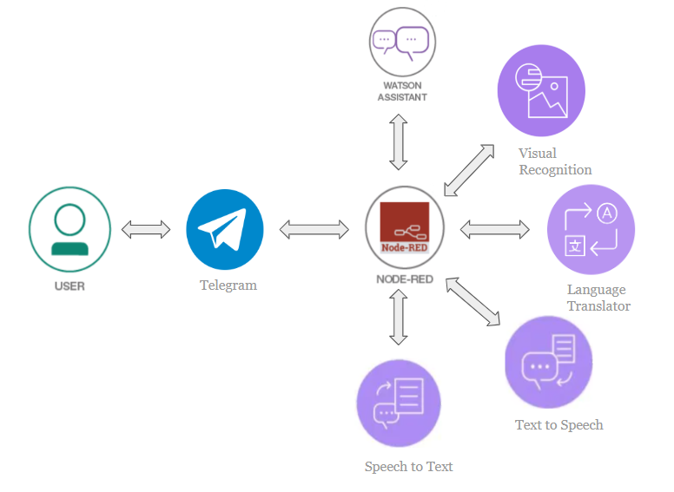

Slide 8
Limitations and Future direction

Slide 9
The proposed solution cannot detect multiple diseases in one image.
The model recognizes 26 plant diseases and 12 healthy plants for now. After training on diverse datasets, our model will be capable of detecting more no.of diseases.
Real time detection using drones on the large fields.
Integrating climate data for crop yield prediction and recommendations.
Ordering fertilizer from ecommerce site.
Setting reminder for pesticides/watering etc.

Slide 10

Thank you!

